Slide 1


Department of ECE
College of Engineering Guindy, Anna University, Chennai
EC5030 – Project Review 2
Presentation for the First Review
29th October, 2025.
DESIGN AND VERIFICATION OF UART COMMUNICATION PROTOCOL USING SYSTEM VERILOG
Presented by:
Umesh Kanna. K. B (2022105010)
Rubesh
Jaganath
B.E - ECE (IVth year)
Under the Guidance of:
Dr. S. R. SRIRAM
Associate Professor
Department of ECE
CEG Campus, Anna University

Slide 2

Overview of Review-I
Design Phase:
1. Objective:
To design a synthesizable UART communication module capable of transmitting and receiving serial data using parameterized timing control.
2. Scope of Work Completed:
Studied UART protocol fundamentals – start bit, data bits, stop bit, and baud rate.
Defined design specifications and timing parameters (CLK_FREQ, BAUD_RATE, CLK_PER_BIT).
Implemented UART Transmitter (serialization) and UART Receiver (deserialization) modules in SystemVerilog.
Verified functionality using a simple RTL-level testbench (direct stimulus).
Simulated using EDA Playground and observed correct TX-RX operation in waveform and log outputs.
3. Deliverables (Review 1):
RTL design files: uart_tx.sv, uart_rx.sv
Basic testbench
Simulation results (waveform + console output)
Preliminary report documenting design flow and results

Slide 3
Review-II
Verification Phase
Objective:
To perform SystemVerilog-based functional verification of the UART design using advanced verification techniques.
2. Proposed Methodology:
Develop a class-based verification environment including Generator, Driver, Monitor, and Scoreboard.
Model transactions to represent UART data frames and randomize test cases.
Use mailbox communication for synchronization between components.
Implement a Scoreboard to compare transmitted and received data for automatic checking.
Execute constrained random testing and coverage-driven simulation.
Analyze simulation results using waveform and console logs.
Validate UART functionality under multiple test scenarios.
3. Expected Deliverables:
Complete verification environment in SystemVerilog
Self-checking testbench and transaction classes
Simulation report (log + waveform)
Coverage analysis and verification summary

Slide 4
Proposed Methodology
Objective:
To verify UART Transmitter and Receiver functionality using a SystemVerilog-based UVM-like architecture.
Testbench Components:
  Test (Top Level) – Initializes the entire testbench and controls simulation flow.
  Environment – Creates and connects all components using mailboxes.
    gen2drv mailbox: Transfers transactions from Generator to Driver.
    mon2scb mailbox: Transfers observed data from Monitor to Scoreboard.
  Generator – Creates test stimulus (UART transactions).
  Transaction – Class object holding a single data byte for UART transfer.
  Driver – Retrieves transactions from gen2drv mailbox and drives DUT inputs.
  Monitor – Captures DUT outputs and sends them to mon2scb mailbox.
  Scoreboard – Compares expected vs. actual data and gives PASS/FAIL results.
  Interface – Connects Testbench to DUT (Tx and Rx lines).
  DUT (UART) – Transmitter and Receiver logic to be verified

Slide 5
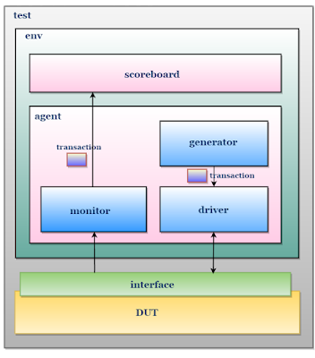
System Verilog TestBench Architecture
Flow:
GENERATOR ⇄ (gen2drv) ⇨ DRIVER ⇨ [TxData, transmit] ⇨ DUT (Tx→Rx) ⇨ MONITOR ⇨ (mon2scb) ⇨ SCOREBOARD ⇨ Pass/Fail Results

Slide 6
How the entire system works at runtime (pipeline / flow)
Testbench initialises interface signals, toggles clock, drops reset.
Environment starts: generator.run() pushes 6 uart_transactions into gen2drv mailbox spaced by #1000.
Driver.run() waits on gen2drv.get(tr). When it gets a transaction:
  Waits for Tx not busy.
  Writes uart.TxData = tr.data, pulses uart.transmit = 1 for one clock.
Uart_Transmitter sees uart.transmit == 1 on next clock, builds tx_shift and sets uart.busy=1. It then begins shifting bits out on uart.TxD once every div_counter clocks — generating start, data bits LSB→MSB, then stop.
The wire uart.TxD is simultaneously connected to the receiver via the interface. Receiver samples uart.TxD using oversampling: it waits for start edge (TxD == 0), then advances sample counters and samples at mid_sample in each div_sample window; collects bits into shift register rxshift_reg.
After the full frame, receiver checks stop bit validity. If valid, it asserts uart.valid_rx and writes uart.RxData.
Monitor.run() polls uart.valid_rx and when asserted captures uart.RxData and puts observed transaction in mon2scb.
Scoreboard.run() reads observed transactions and compares them to expected list and prints PASS/FAIL.
This loop repeats for all 6 bytes. Then environment tasks complete and testbench ends.

Slide 7
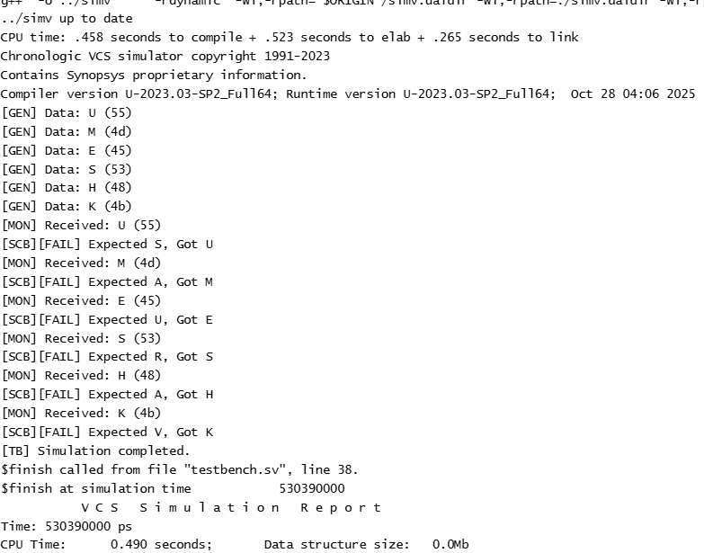
Console Output

Slide 8
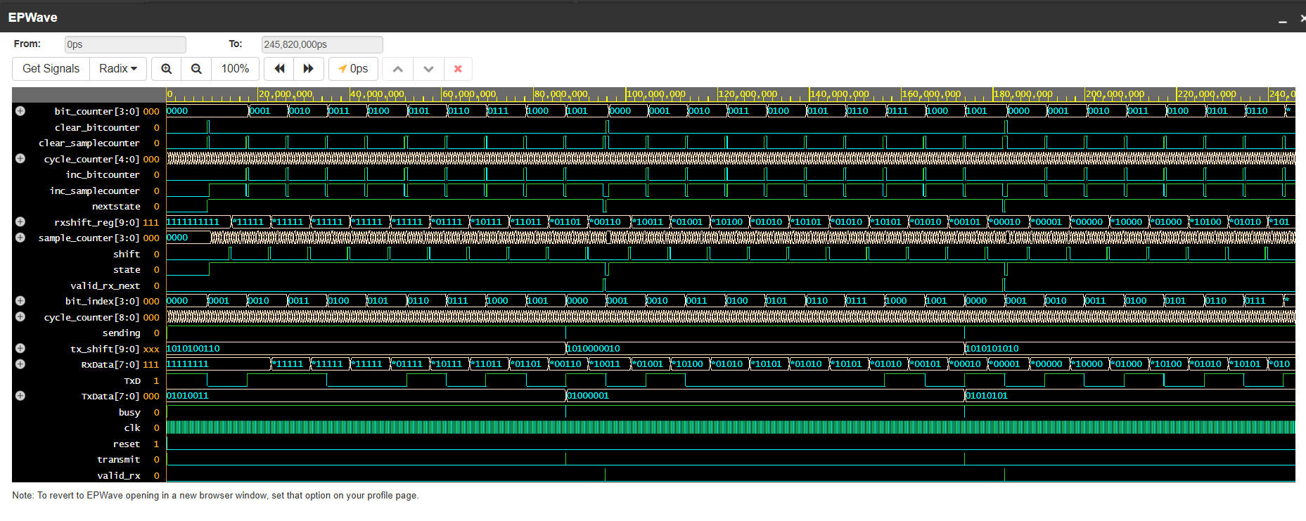
Output Waveform

Slide 9


